Slide 1

Fingerprint Liveness Detection

Slide 2

Fingerprint Liveness Detection
V SEM MINI PROJECT
Course Code: 15ECSW301
Team Number: M21
Priyanka C Pardeshi 01FE19BCS014 111
Manisha Belagal 01FE19BCS207 407
Mehar Anjum 01FE19BCS208 408
Devyansh Agrawal 01FE19BCS245 443
Under the guidance of
Mrs. Neha Tarannum
2021-22 Odd Semester
SOCSE, KLE TECHNOLOGICAL UNIVERSITY-HUBLI

Slide 3
PROBLEM STATEMENT
To develop a system that classifies the given
sample of fingerprint into real or fake and also
categorise the spoofing material used for fake
fingerprint , using deep learning techniques.

Slide 4

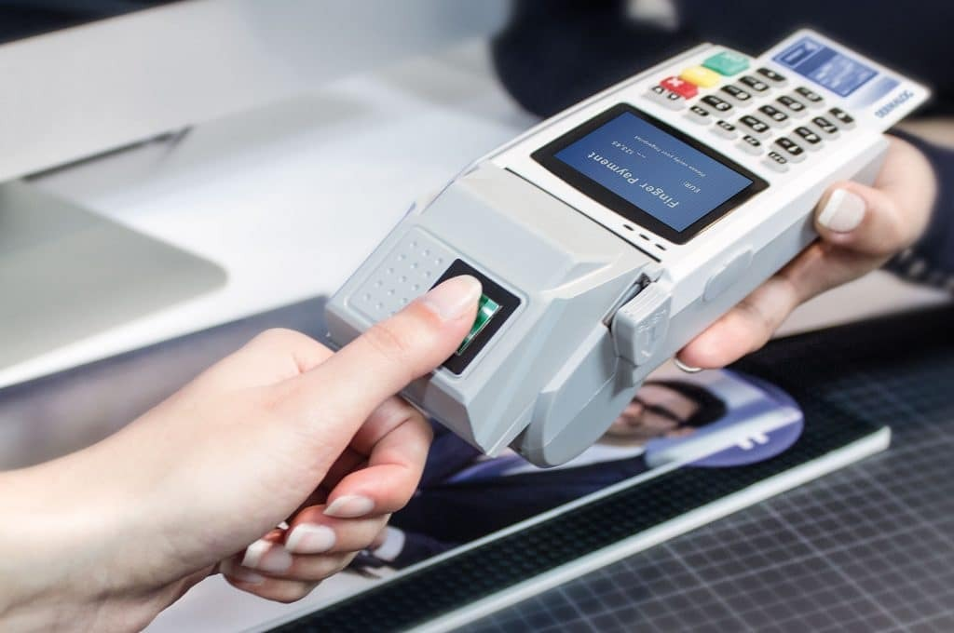
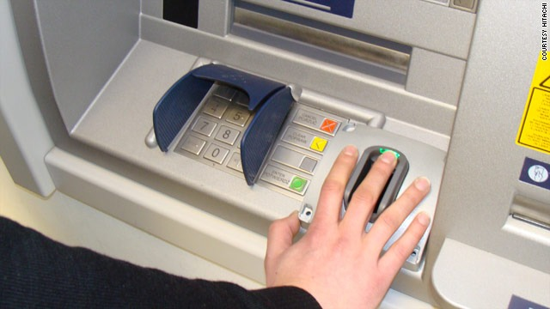
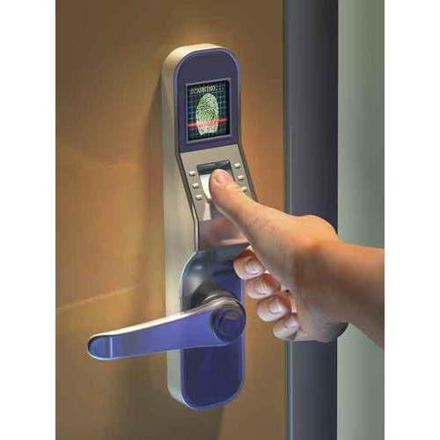
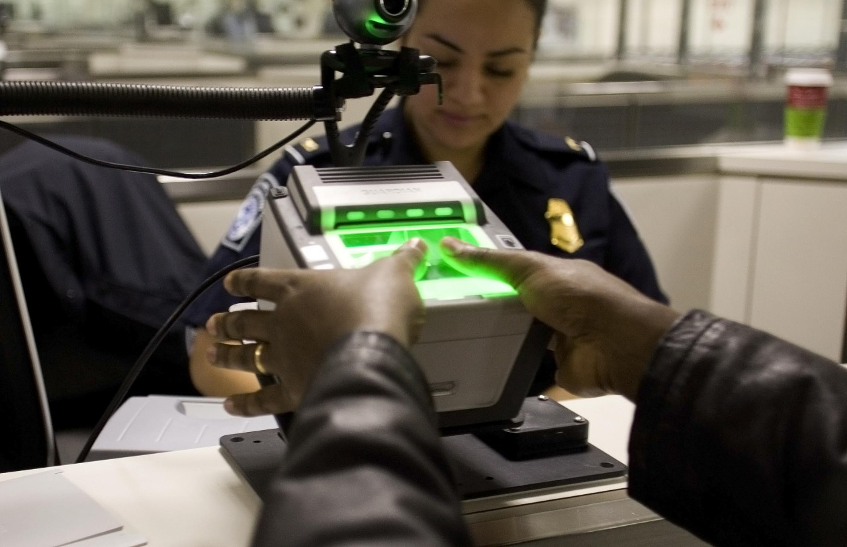
MOTIVATION

Slide 5
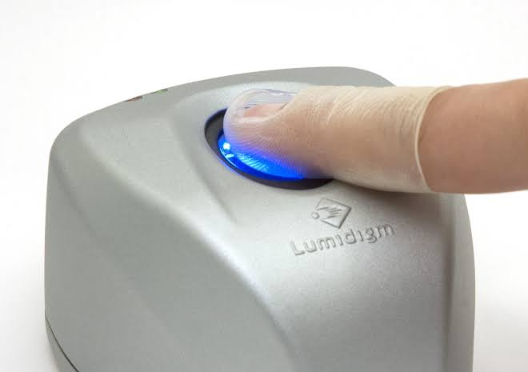
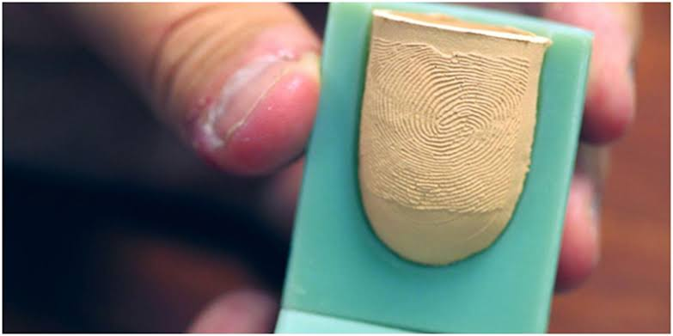
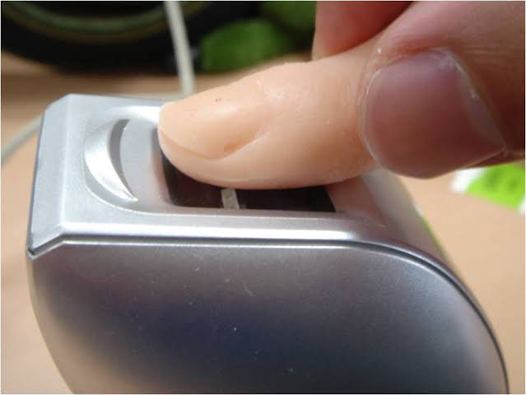
MOTIVATION
Fake fingerprint can be made of body double , ecoflex and play doh which resembles the original fingerprint.

Slide 6





Why? What? How?
Why?
To reduce the risk of spoofing the biometric system.
What?
To detect if the fingerprint is real or fake.
How?
Using deep learning techniques .

Slide 7
OBJECTIVE
▪ To Deblur the given fingerprint sample if required.
▪ To extract the features of the fingerprint.
▪ To detect if the given fingerprint sample is Fake or Real.
▪ To classify the spoofing material when the detected sample is fake.
▪ To design graphical user interface for the model.

Slide 8
SCOPE AND CONSTRAINT
The scope of this project is restricted to detect whether given fingerprint sample is real or fake and not in fingerprint recognition.

Slide 9
Literature Survey
LITERATURE SURVEY
Paper Title: Detection of Fingerprint Authenticity Based on Deep Learning Using Image Pixel Value .
Authors: Hariyanto, Sunny Arief Sudiro, Tubagus Maulana Kusuma, Sarifuddin Madenda, Laode M. Rasdi Rere
Date Published: 24 December 2020
Learning: This research proposes a method based on deep learning with the CNN algorithm for the implementation of the authenticity of fingerprint detection. Experiments were performed on a fingerprint dataset with a variety of different parameters to see the best accuracy results.

Slide 10
Literature Survey
LITERATURE SURVEY
2. Paper Title: Convolutional Neural Networks for Fingerprint Liveness Detection System
Authors: Arun Kumar T K , Vinayakumar R , Sajith Variyar V V , Sowmya V , Soman K P
Date Published: 16 April 2020
Learning: This paper uses CNN for feature extraction and classification of fingerprints into live or fake. A comparison study was made where the features extracted from CNN are applied to various machine learning algorithms such as SVM, KNN etc .From the comparison study of deep learning based and machine learning based classifiers, it was observed that both models gave almost similar performances with a maximum test accuracy of 95%.

Slide 11
LITERATURE SURVEY
3. Paper Title: Overview of Fingerprint Recognition System
Authors: Mouad M.H. Ali, Pravin Yannawar, Vivek Hilal Mahale,Ashok Gaikwad
Date Published: March 2016
Learning: This paper gives us an overview on the main steps involved in fingerprint authentication that are: Image Capture or Image Acquisition stage, Image Preprocessing stage, Feature extraction stage, Matching stage. It also talks about the previous processes and algorithms used for each step.

Slide 12
LITERATURE SURVEY
4. Paper Title: Fingerprint Liveness Detection by a Testing and Trained Data using Convolutional Neural Network
Authors: Vishwas Prakash. R, Dr. Mohan Kumar H. P
Date Published: 2020
Learning: This paper states about the precision of the liveness model by admitting the dataset (i.e. fingerprint) to be live or fake. The proposed method uses the fingerprints referring to the trained and test fingerprints using convolution neural networks to render a judgment on liveliness. The liveness is checked by feature extraction, testing and training phases. Using CNN and various algorithms for classification like decision tree, Randomforest, Logistic Regression, Neural Net, Gradient Boosting and Naive Bayes the model has been implemented.

Slide 13
LITERATURE SURVEY
5.Paper Title: Evaluating software-based fingerprint liveness detection using Convolutional Networks and Local Binary Patterns.
Authors: Rodrigo Frassetto Nogueira, Roberto de Alencar
Date Published: 10 October 2015
Learning: This research proposes a method based on deep learning with the CNN algorithm and Local Binary Pattern. Both techniques were used in conjunction with a Support Vector Machine (SVM) classifier. Dataset Augmentation was used to increase classifier’s performance and a variety of preprocessing operations were tested for the implementation of the authenticity of fingerprint detection

Slide 14
LITERATURE SURVEY
6. Paper Title: Transformers and Generative Adversarial Networks for Liveness Detection in Multitarget Fingerprint Sensors
Authors: Soha B. Sandouka, Yakoub Bazi and Naif Alajlan
Date Published: 20 January 2021
Learning: The aim of this paper is to increase the accuracy for cross sensor and cross materials. CycleGAN is used to generate augmented versions of fingerprint.Then a pre trained CNN is used together with a transformer to form a hybrid network. It contains three main components, which are: a CNN backbone to extract a compact feature representation of a fingerprint, a transformer, and cycleGAN.

Slide 15
Literature Survey
LITERATURE SURVEY
7. Paper Title: FDeblur-GAN: Fingerprint Deblurring using Generative Adversarial Network.
Authors: Amol S. Joshi,Ali Dabouei,Jeremy Dawso, Nasser M. Nasrabadi
Date Published: 21 JUNE 2021
Learning: This research proposes a method to De-Blur the fingerprint samples acquired from crime scenes, mobile cameras, or low-quality sensors. This paper uses FDeblur-GAN, based on the cGANs and multi-stage framework of the stack GAN used. The first sub-network is a ridge extractor model. It is added to generate ridge feature maps to ensure that fingerprint information are preserved in the deblurring process. The second sub-network is a verifier that helps the generator to preserve the fingerprint information during the generation process. Using a database of blurred fingerprints and corresponding ridge maps, the deep network learns to deblur from the input samples. The discriminators, ridge extractor, and verifier, work simultaneously to enhance the deblurring process.

Slide 16

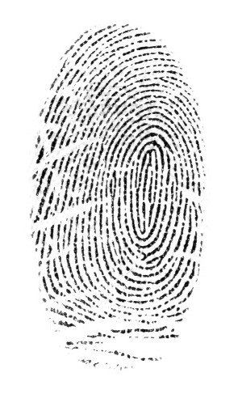
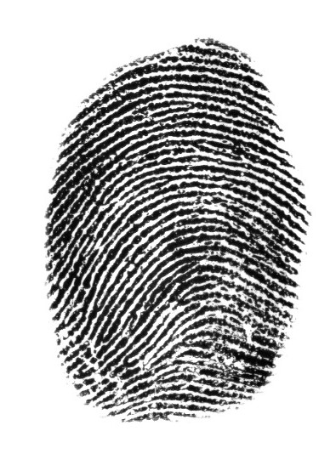
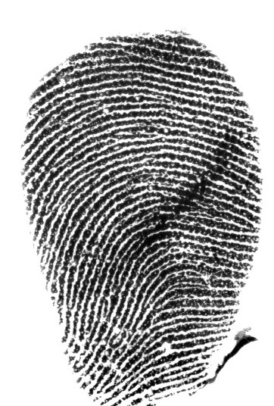
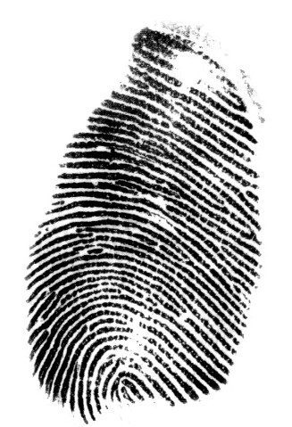
DATA SET
Livdet 2019-Dataset taken from University of Cagliari, Department of Electrical and Electronic Engineering and
Clarkson University, Department of Electrical and Computer Engineering
Live Fingerprint
Fake Fingerprint
Body Double
Ecoflex
Playdoh

Slide 17
DATASET ANALYSIS
The dataset which we acquired consists of real and fake fingerprint samples with different sensors.
The fake fingerprint sample consists of different spoofing materials i.e Body Double , Ecoflex , Playdoh ,Gelatine , Latex , Wood glue.
Total training images – 8983 (4473 fake fingerprints ,4510 live fingerprints).
Total testing images - 6551 (2051 fake fingerprints ,4500 live fingerprints).
Body Double
Ecoflex
Playdoh

Slide 18
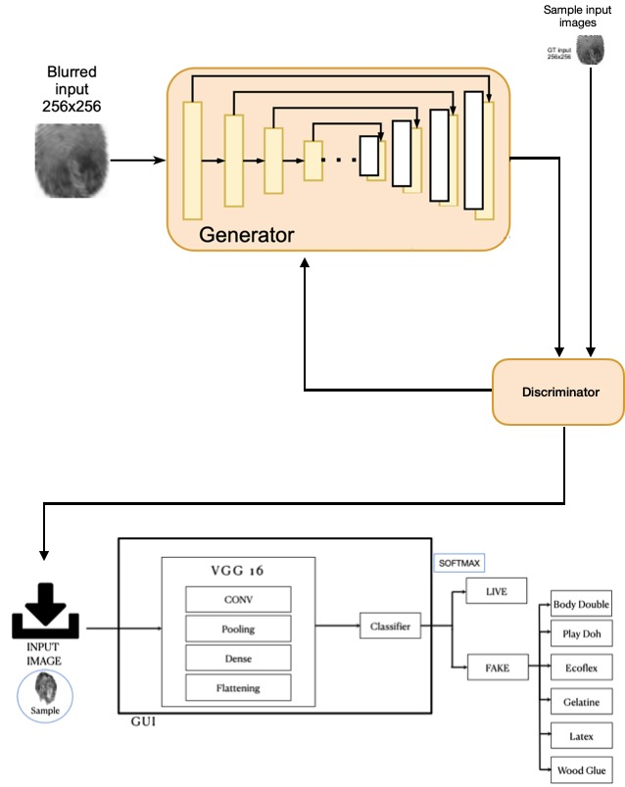
BLOCK DIAGRAM
Body Double
Ecoflex
Playdoh

Slide 19
FUNCTIONAL REQUIREMENTS
User :
1. The user shall be able to successfully login into the system.
System :
1.1 The user shall be able to enter the User-Id & password.
1.2 The user shall be able to see a warning message if the entered credentials are invalid.

Slide 20
FUNCTIONAL REQUIREMENTS
User :
2. User shall be able to upload the image.
System :
2.1 The user shall be able to upload the image only in .jpeg or .png format.
2.2 The user shall be able to view the uploaded image.

Slide 21
FUNCTIONAL REQUIREMENTS
User :
3. User shall be able to view the result.
System :
3.1 The user shall be able to view the result i.e real or fake.
3.2 The user shall be able to view the spoofing material i.e., ecoflex, body double and play doh if it’s a fake fingerprint .

Slide 22
NON-FUNCTIONAL REQUIREMENTS
The desired output should be displayed within 3 seconds.
The user should be redirected to the homepage after login within 3 seconds.
The format of the input image should be either .jpeg or .png.
To attain the accuracy of at least 90% for determining the authenticity of the fingerprint.
The minimum requirement of this system is 8 GB RAM ,Windows 8 operating system.

Slide 23
USE CASE DIAGRAM
Login to the system
Enter the User ID and Password
<<include>>
Upload the input Image
USER
View Live/Fake
View spoofing material for fake image
<<extend>>

Slide 24
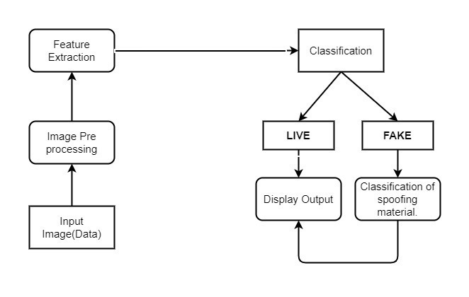
ARCHITECTURE
Pipe And Filter Architecture

Slide 25
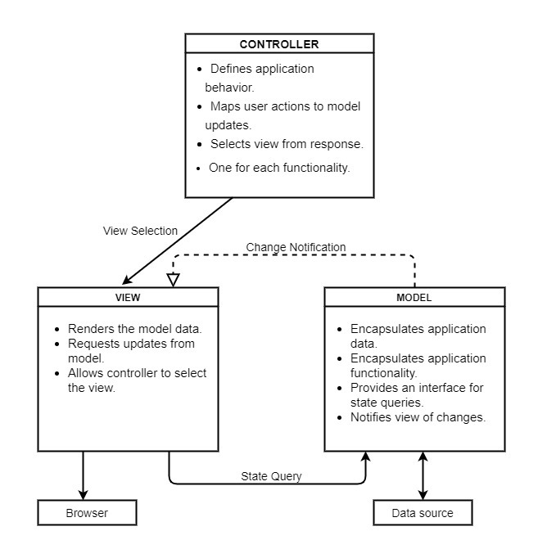
ARCHITECTURE
Model View Controller Architecture For GUI

Slide 26
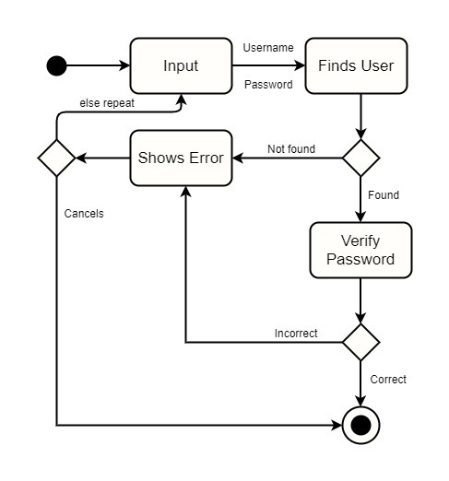
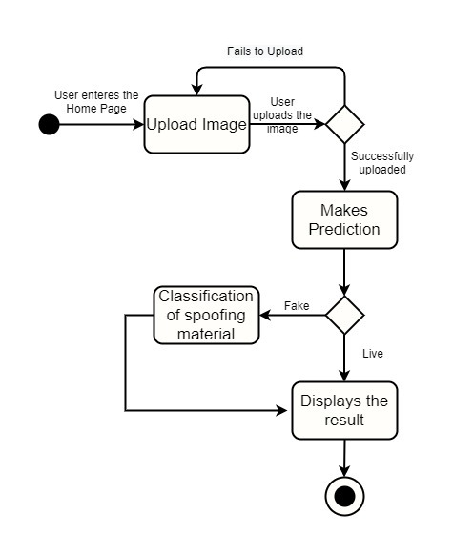
ACTIVITY DIAGRAM
User Login
Upload Image

Slide 27
IMPLEMENTATION
Data Pre-processing
Re-scaling : Helps to get the pixel value between 0 and 1.
Shear range : image will be distorted along an axis, mostly to create or rectify the perception angles.
Zoom range :This method randomly zooms the image either by zooming in or it adds some pixels around the image to enlarge the image.
Horizontal flipping : Reversing the entire rows and columns of an image pixels horizontally
Model Used : Convolution Neural Network , VGG16

Slide 28
IMPLEMENTATION RESULTS
CNN | VGG-16
4 convopool layers are used Contains 2 modules: feature extraction module and classifier module | VGG16 is a CNN architecture that has 16 layers. 13 convolutional layers , 5 max pooling layers and 3 dense layers.
Transformations 1.shear_range = 0.2 2.zoom_range = 0.2 3.horizontal_flip = True | Transformations 1.shear_range = 0.2 2.zoom_range = 0.2 3.horizontal_flip = True
Accuracy -91.91 % | Accuracy – 94.23%
Loss -0.2880 | Loss – 0.2423

Slide 29
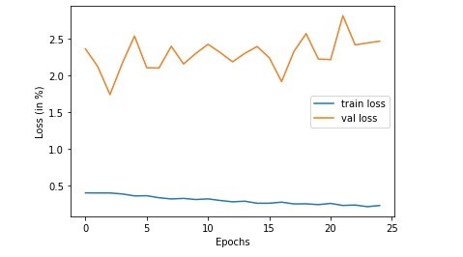
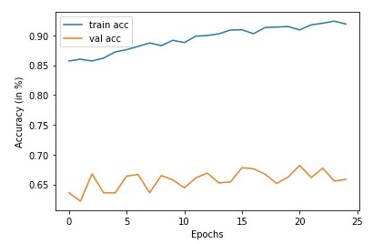
IMPLEMENTATION RESULTS
Graph of Loss vs Epoch
Graph of Accuracy vs Epoch

Slide 30
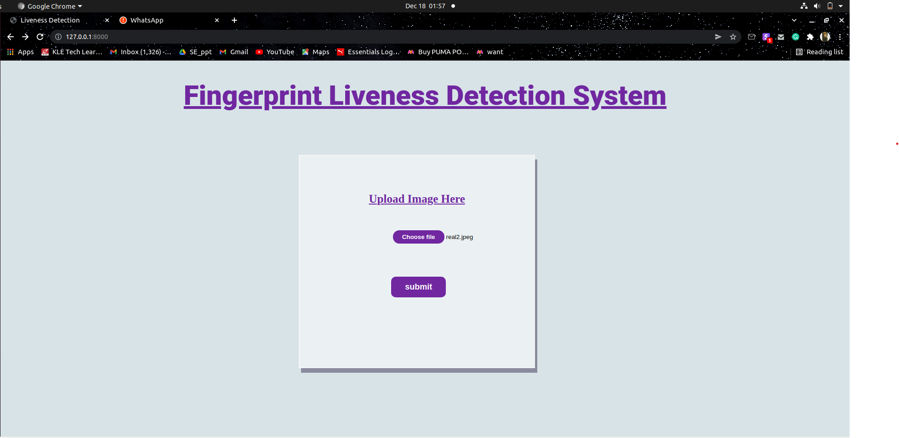
IMPLEMENTATION RESULTS
GUI for Liveness Detection using Django Framework

Slide 31
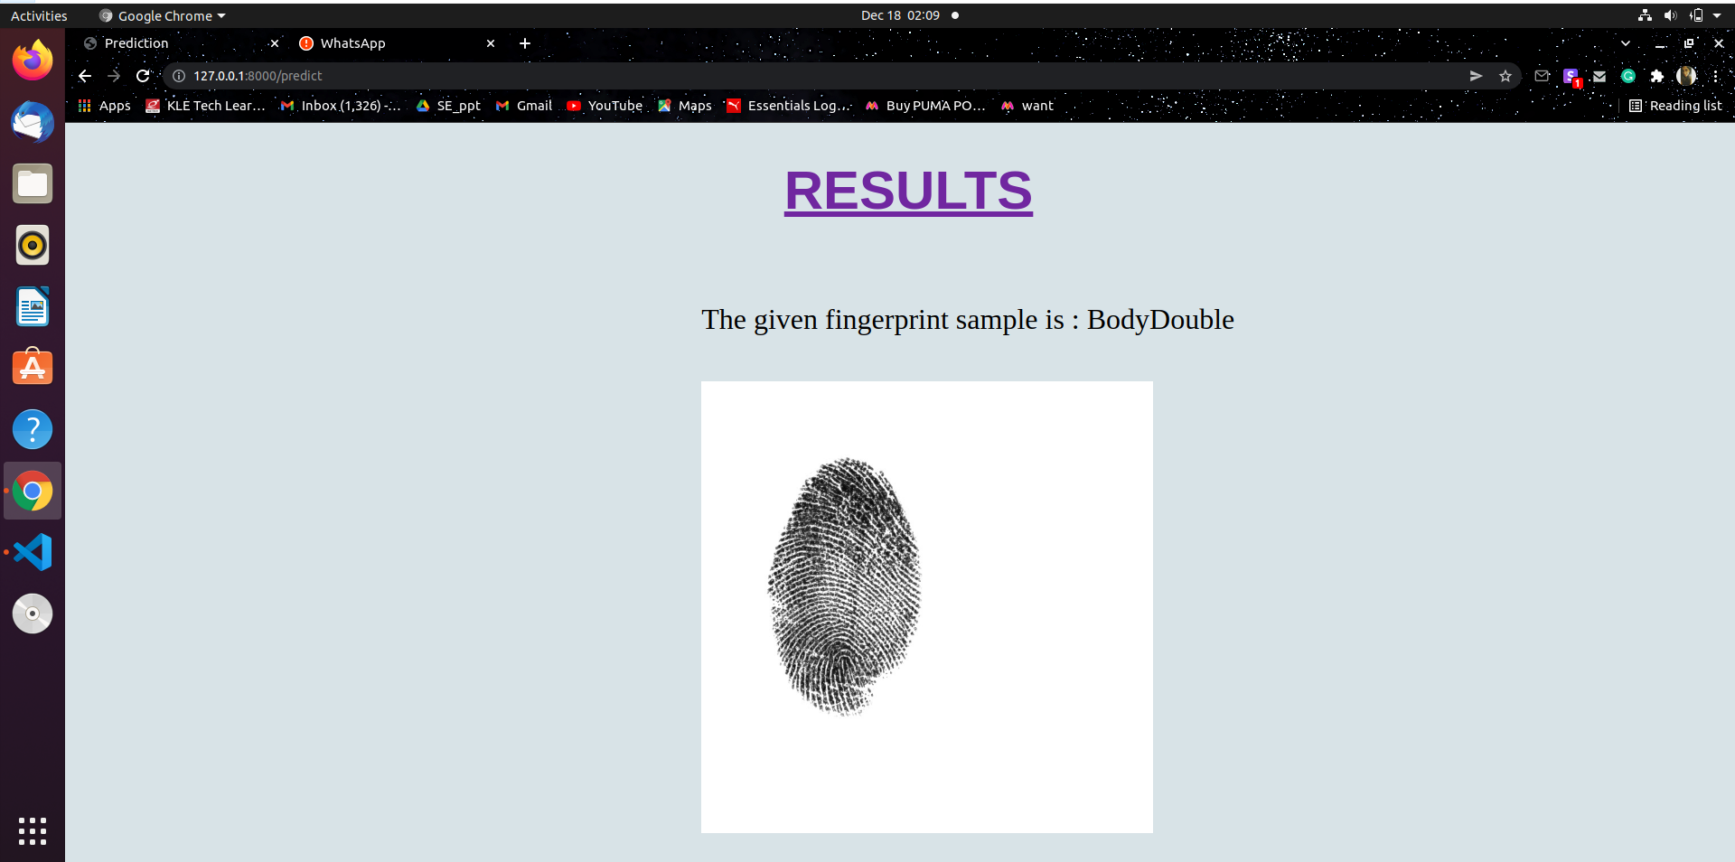
IMPLEMENTATION RESULTS
Output for Fake Fingerprint

Slide 32
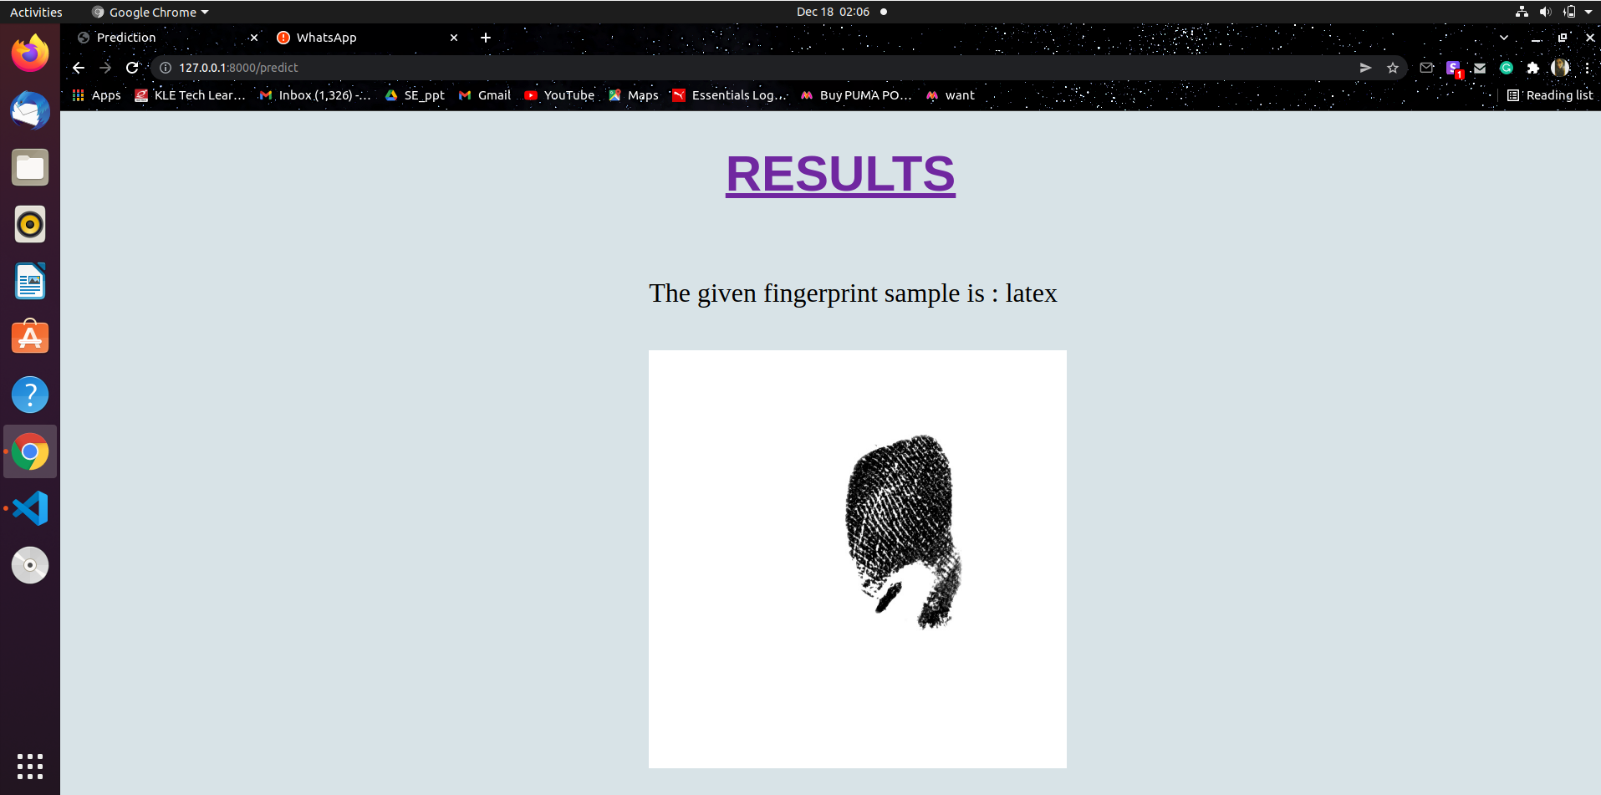
IMPLEMENTATION RESULTS
Output for Fake Fingerprint

Slide 33
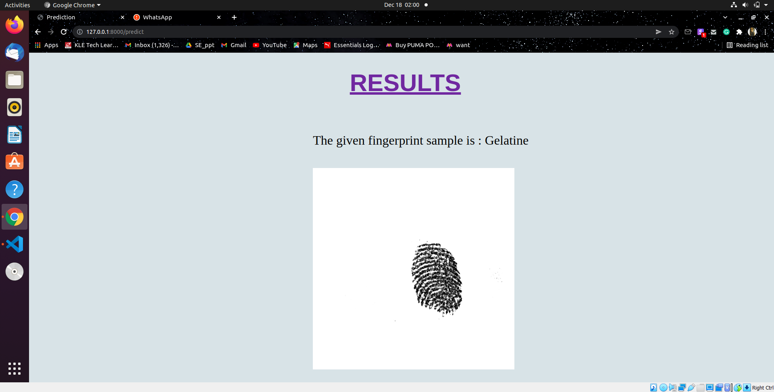
IMPLEMENTATION RESULTS
Output for Fake Fingerprint

Slide 34
REFERENCES
Free-form image inpainting with gated convolution. Yu et al. In ICCV 2019
2. Region Normalization for Image Inpainting. Tao et al. In AAAI 2020
3. Learning to Incorporate Structure Knowledge for Image Inpainting, Yang et al. In AAAI 2020
4. Prior Guided GAN Based Semantic Inpainting, Lahiri1 et al. In CVPR 2020
5. UCTGAN: Diverse Image Inpainting based on Unsupervised Cross-Space Translation, Zhao et al. In CVPR 2020
6. Recurrent Feature Reasoning for Image Inpainting, Li et al. In CVPR 2020
7. Contextual Residual Aggregation for Ultra High-Resolution Image Inpainting, Yi et al., In CVPR 2020
8. 3D Photography using Context-aware Layered Depth Inpainting, Shih et al. In CVPR 2020
9. Rethinking Image Inpainting via a Mutual Encoder-Decoder with Feature Equalizations, Liu et al. In ECCV 2020
10. Guidance and Evaluation: Semantic-Aware Image Inpainting for Mixed Scenes, Liao et al. In ECCV 2020

Slide 35
THANK YOU

